Slide 1

ITS323/CSS331
Transmission
Media
Media and
Spectrum
Transmission Media
Guided Media
Wireless
Transmission
Antennas
Propagation
Wireless Examples

Slide 2
ITS323/CSS331
Contents
Transmission
Media
Media and
Spectrum
Transmission Media and Spectrum
Guided Media
Wireless
Transmission
Guided Media
Antennas
Propagation
Wireless Transmission
Wireless Examples
Antennas and Antenna Gain
Propagation and Path Loss
Wireless Examples

Slide 3
Transmission Media
All computer communication involves encoding data in a form of energy, and sending the energy across a transmission medium (i.e., the network links).
Guided and Unguided Media
Links can be categorized by the type of path used:
Guided Media: communication follows an exact path (such as a wire)
Unguided Media: communication follows no specific path (such as a radio transmission)
Forms of Energy
Links can be categorized by the type of energy used for transmission:
Electrical Energy is used on wires
Radio Frequency Transmission is used for wireless
Light is used for optical fibers and lazers

Slide 4
Taxonomy by Forms of Energy

Slide 5
ITS323/CSS331
Transmission Media
“the thing between the transmitter and receiver”
Transmission
Media
Media and
Spectrum
I
Signal propagates from transmitter to receiver via some
medium
Which medium should be used?
Guided Media
Wireless
Transmission
I
�
�
�
�
�
Maximise data rate
Maximise distance
Minimise bandwidth
Minimise transmission impairments
Minimize cost
Antennas
Propagation
Wireless Examples
I
Guided (wired) vs unguided (wireless)

Slide 6
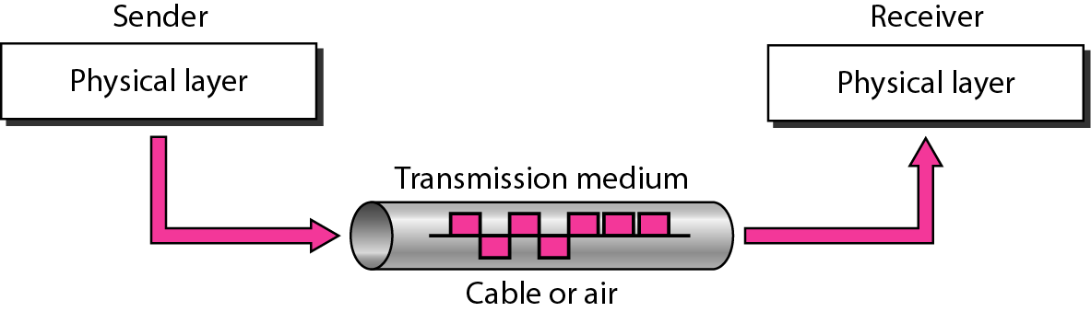
Physical Layer

Slide 7
ITS323/CSS331
Signals and Spectrum
Transmission
Media
I
Communication signals contain components with
different frequencies, spectrum of signal
Often refer to center frequency and bandwidth of signal
Media and
Spectrum
Guided Media
I
Wireless
Transmission
S(f)
Antennas
b
70%
Propagation
Wireless Examples
andwidth
low centre cutoff
high cutoff
f
I
I
Electromagnetic spectrum is used by many applications
International and national authorities regulate usage of spectrum
Aim: minimize interference between applications/users, while allowing many applications/users
I

Slide 8
ITS323/CSS331
Electromagnetic Spectrum for Communications
Transmission
Media
Frequency [Hz]
10⁰
Media and
Spectrum
10³
10⁶
10⁹
₁₀12 ₁₀15
₁₀18 ₁₀21
Visible
Guided Media
Radio
Microwave
THz
Infrared
Ultraviolet
X−ray
Gamma
Wireless
Transmission
3kHz
300MHz 300GHz 3THz
30PHz
30EHz
Wavelength [m] 10⁵
10⁰
₁₀−3 ₁₀−4
₁₀−8
₁₀−11
Antennas
Twisted Pair
WiFi
Remote
Propagation
ADSL
FM
3G
Optical
Fibre
AM
Satellite
TV
Wireless Examples
Coaxial Cable
ITU and IEEE bands:
VLF
LF
MF
HF
UHF
VHF
SHF
EHF
THF
3kHz 30kHz 300kHz 3MHz 30MHz 300MHz 3GHz 30GHz 300GHz 3THz
ITU
L S
C X K _{u}
K
K _{a}
1 2 4 8 12
18
27
40GHz
IEEE

Slide 9
ITS323/CSS331
Contents
Transmission
Media
Media and
Spectrum
Transmission Media and Spectrum
Guided Media
Wireless
Transmission
Guided Media
Antennas
Propagation
Wireless Transmission
Wireless Examples
Antennas and Antenna Gain
Propagation and Path Loss
Wireless Examples

Slide 10
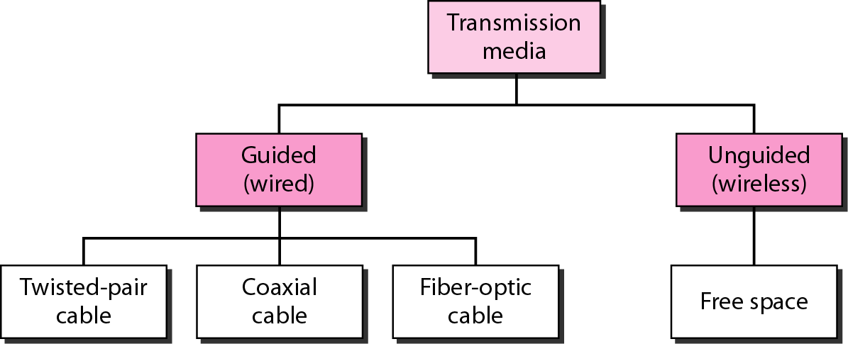
Classes of Transmission Media

Slide 11
Guided Media
Provide a conduit from one device to another
Include
twisted-pair cables
coaxial cables
fiber-optic cables

Slide 12
ITS323/CSS331
Electrical Cables
Transmission
Media
I
I
Transmit electrical signals on a conductor, e.g. copper
Cable carrying electrical current radiates energy, and can pick-up energy from other sources
Media and
Spectrum
Guided Media
�
�
�
Can cause interference on other cables
Other sources can cause interference on the cable
Interference results in poor quality signals being received
Wireless
Transmission
Antennas
Propagation
I
To minimise interference:
Wireless Examples
�
�
�
Keep the cable lengths short
Keep the cables away from other sources
Design the cables to minimise radiation and pick-up
�
�
Use materials to shield from interference
Organise multiple wires so they dont interfere with each other

Slide 13

ITS323/CSS331
Twisted Pair
Transmission
Media
I
I
Two insulated copper wires arranged in spiral pattern
Most commonly used and least expensive medium
Media and
Spectrum
Guided Media
�
Used in telephone networks and in-building
communications
Telephone networks designed for analog signalling (but supporting digital data)
Also used for digital signalling
Wireless
Transmission
�
Antennas
Propagation
�
Wireless Examples
I
Two varieties of twisted pair: shielded (STP) and
unshielded (UTP); also multiple categories (CAT5)

Slide 14
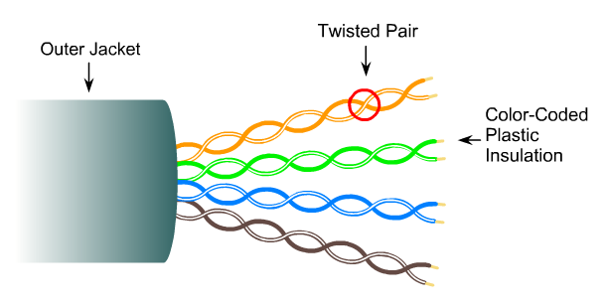
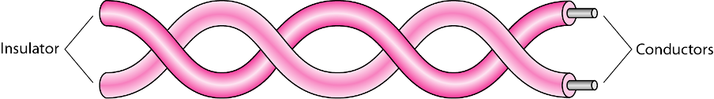
Twisted-Pair Cable

Slide 15
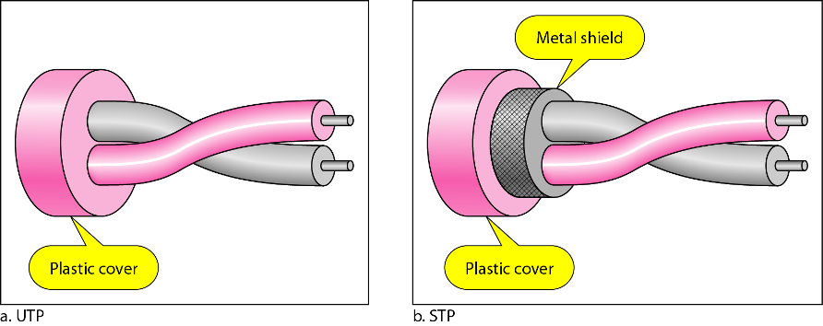
UTP and STP Cables
UTP – Unshielded Twisted Pair
STP –Shielded Twisted Pair

Slide 16
Categories of UTP/STP Cables

Slide 17
Categories of UTP/STP Cables
Category | Bandwidth | Digital/Analog | Use
1 | very low | Analog | Telephone
2 | < 2 MHz | Analog/digital | 4Mbps token ring
3 | 16 MHz | Digital | 10-100 Mbps Ethernet
4 | 20 MHz | Digital | 16 Mbps token ring
5 | 100 MHz | Digital | 100 – 1000 Mbps Ethernet
5E | 100 MHz | Digital | 100 – 1000 Mbps Ethernet
6 | 250 MHz | Digital | 1 – 10 Gbps Ethernet
6A | 500 MHz | Digital | 1 – 10 Gbps Ethernet
7 | 600 MHz | Digital | 10 Gbps Ethernet
7A | 1000 MHz | Digital | 40-100 Gbps Ethernet

Slide 18
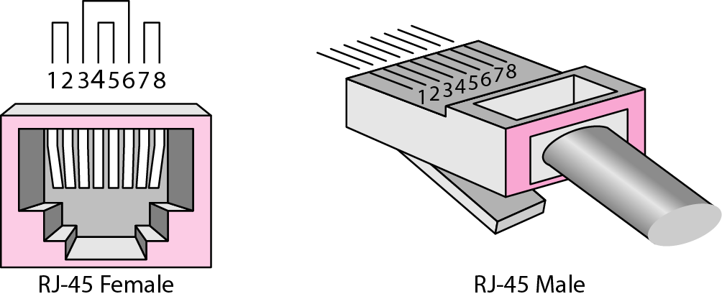
UTP Connectors
RJ – Registered Jack

Slide 19
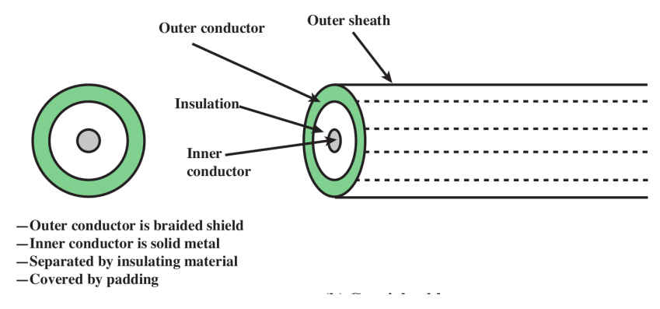
ITS323/CSS331
Coaxial Cable
Transmission
Media
I
I
Two conductors, one inside the other
Provide much more shielding from interference than twisted pair: Higher data rates; More devices on a shared line; Longer distances
Widely used for cable TV, as well as other audio/video cabling
Used in long-distance telecommunications, although optical fibre is more relevant now
Media and
Spectrum
Guided Media
Wireless
Transmission
I
Antennas
Propagation
I
Wireless Examples

Slide 20
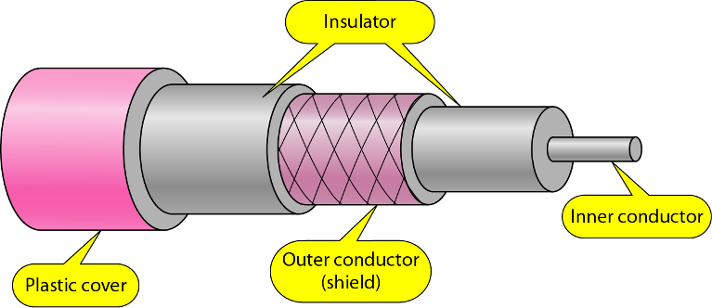
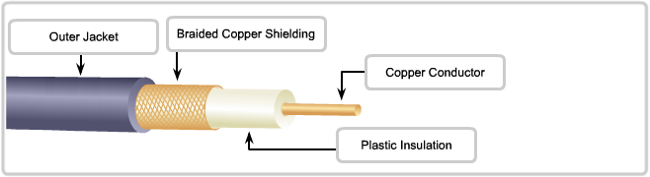
Coaxial Cable

Slide 21
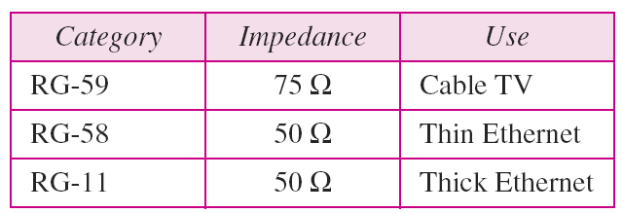
Categories of Coaxial Cables
RG – Radio Government

Slide 22
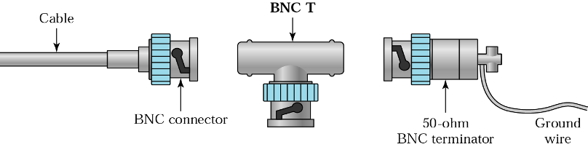
BNC Connectors
Bayonet Network Connector
aka. Bayonet Neil-Concelman
Used with coaxial cables

Slide 23
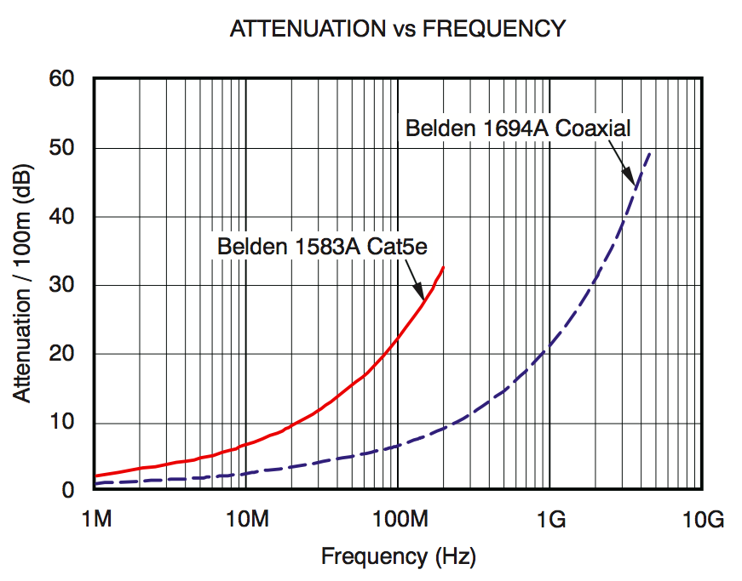
UTP and Coaxial Performance
www.ti.com/lit/an/sboa123/sboa123.pdf

Slide 24
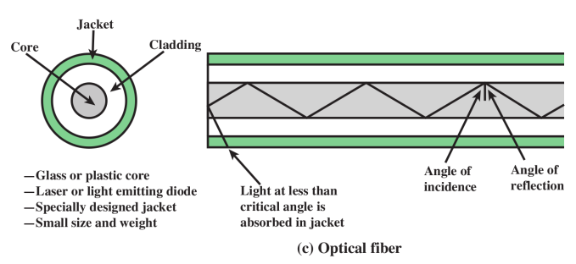
ITS323/CSS331
Optical Fibre
Transmission
Media
I
Light (optical rays) is guided within glass or plastic
fibres
Used in long-distance telecommunications, as well as telephone systems, LANs, and city-wide networks Advantages of optical fibre over electrical cables:
Media and
Spectrum
I
Guided Media
Wireless
Transmission
I
Antennas
1.
2.
Lower loss: can transfer larger distances
Higher bandwidth: a single fibre is equivalent to 10’s or
100’s of electrical cables
Small size, light weight: lowers cost of installation
Electromagnetic isolation
Propagation
Wireless Examples
3.
4.

Slide 25
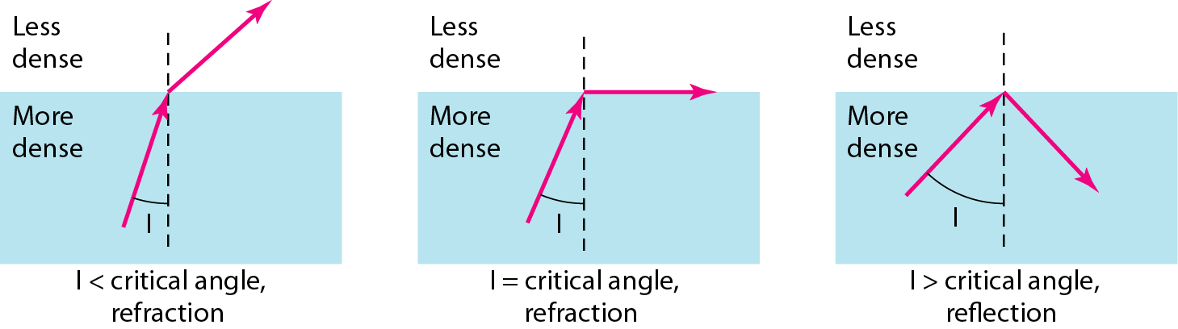
Optical Fiber
Based on physics of light

Slide 26
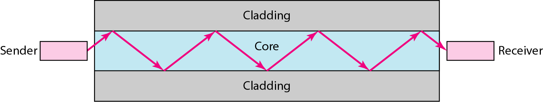
Optical Fiber

Slide 27
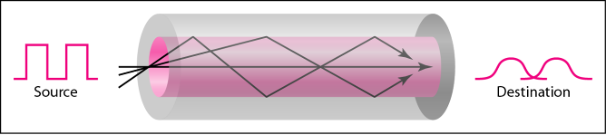
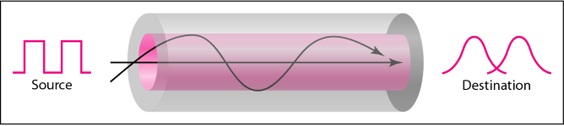
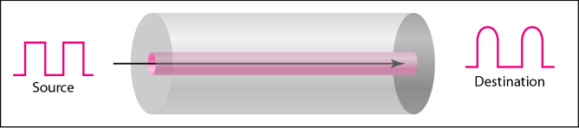
Propagation Modes
Multi-mode, step index
Multi-mode, graded index
Single-mode

Slide 28
Fiber Types

Slide 29
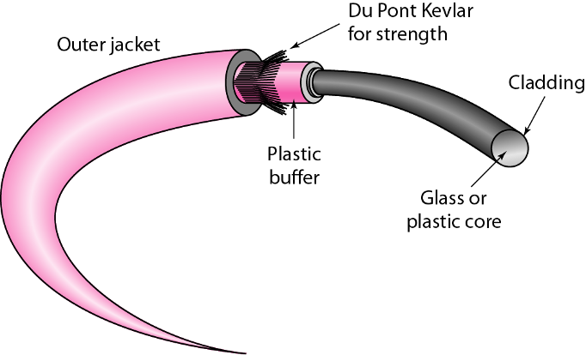
Fiber Construction

Slide 30
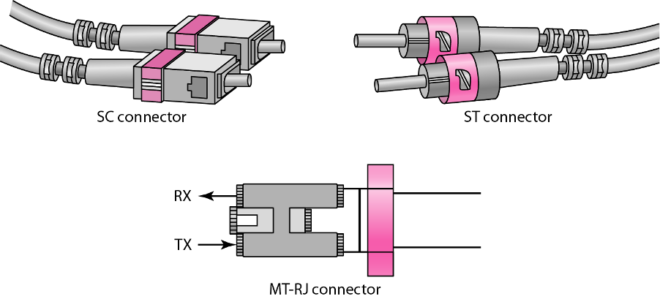
Fiber-Optic Cable Connectors

Slide 31
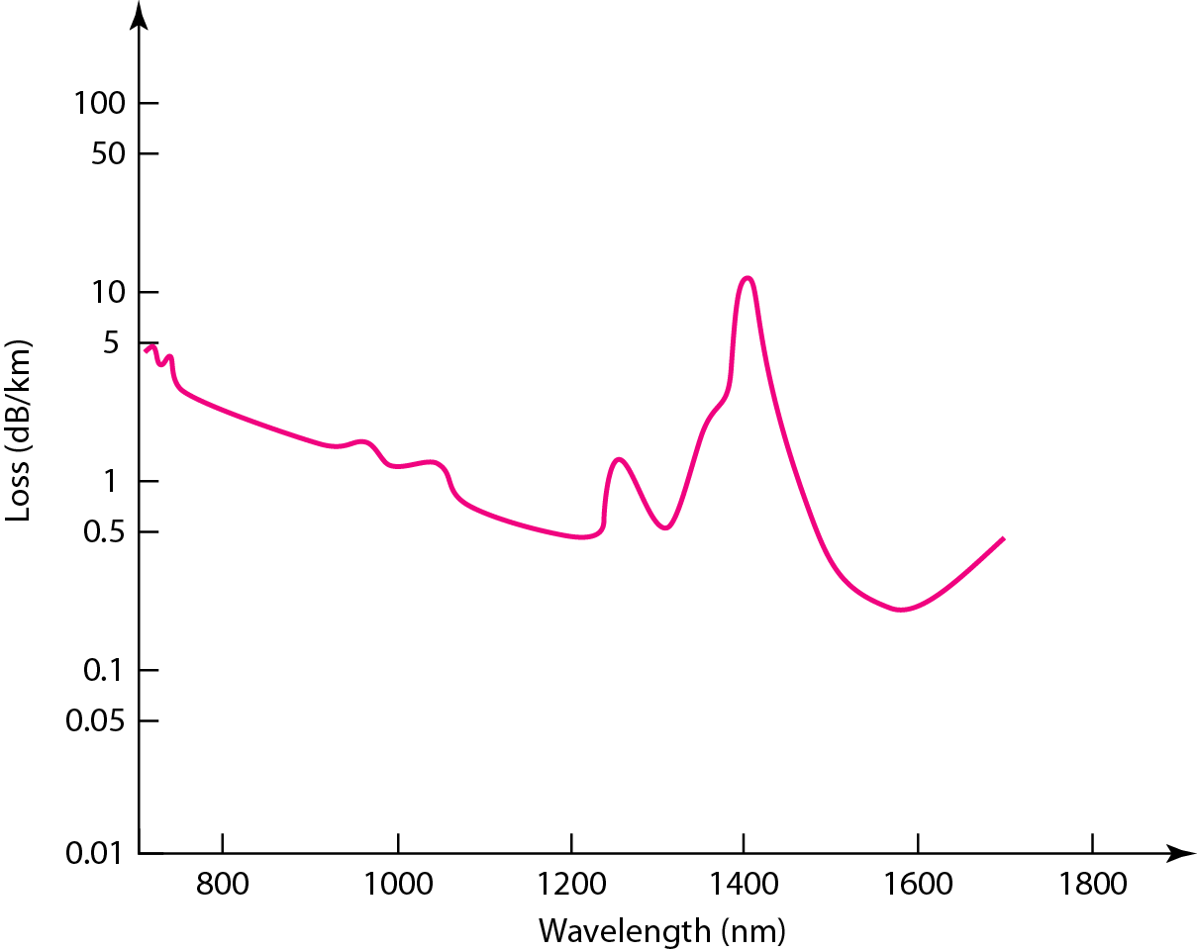
Optical Fiber Performance

Slide 32
ITS323/CSS331
Comparison of Guided Media
Electrical Cables
Transmission
Media
Media and
Spectrum
I
Moderate data rates: lGb/s
Maximum distance: 2km (twisted pair); lOkm (coaxial)
Cheapest for low data rates
UTP: easy to install, susceptible to interference
STP, Coaxial Cable: rigid, protection against interference
Guided Media
Wireless
Transmission
I
I
Antennas
Propagation
I
Wireless Examples
I
Optical Cables
Very high data rates: lOOGb/s+
I
I
Maximum distance: 4Okm
Expensive equipment, but cost effective for high data rates
Difficult to install
I
I

Slide 33
ITS323/CSS331
Contents
Transmission
Media
Media and
Spectrum
Transmission Media and Spectrum
Guided Media
Wireless
Transmission
Guided Media
Antennas
Propagation
Wireless Transmission
Wireless Examples
Antennas and Antenna Gain
Propagation and Path Loss
Wireless Examples

Slide 34
Unguided Media: Wireless
Transport electromagnetic waves without using a physical conductor
Radio Waves
Microwaves
Infrared
Often referred to as wireless communication

Slide 35
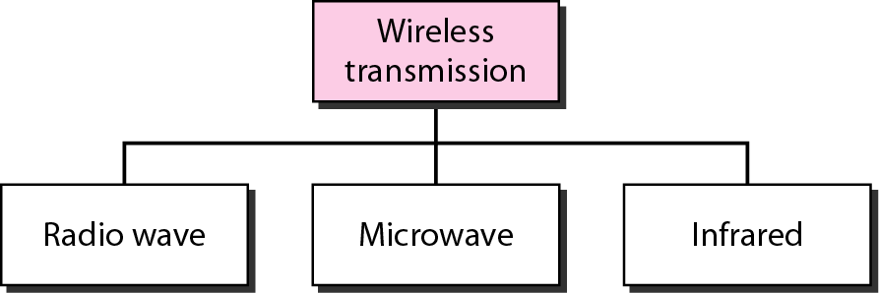
Wireless Transmission Waves
used for multicast/broadcast communications, such as radio and television
used for unicast communication such as cellular telephones, satellite networks, and wireless LANs
used for short-range communication in a closed area using line-of-sight propagation

Slide 36
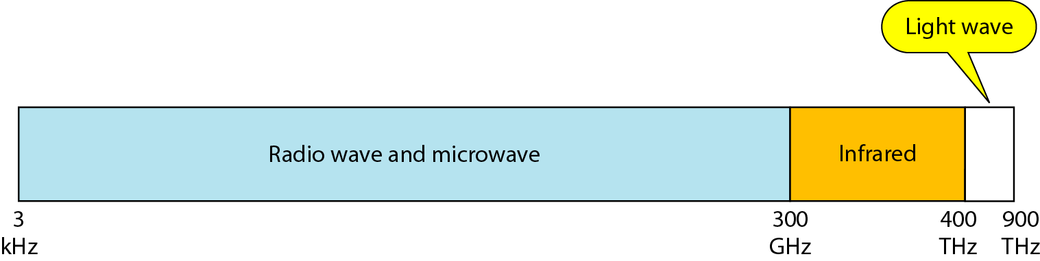
Electromagnetic Spectrum

Slide 37
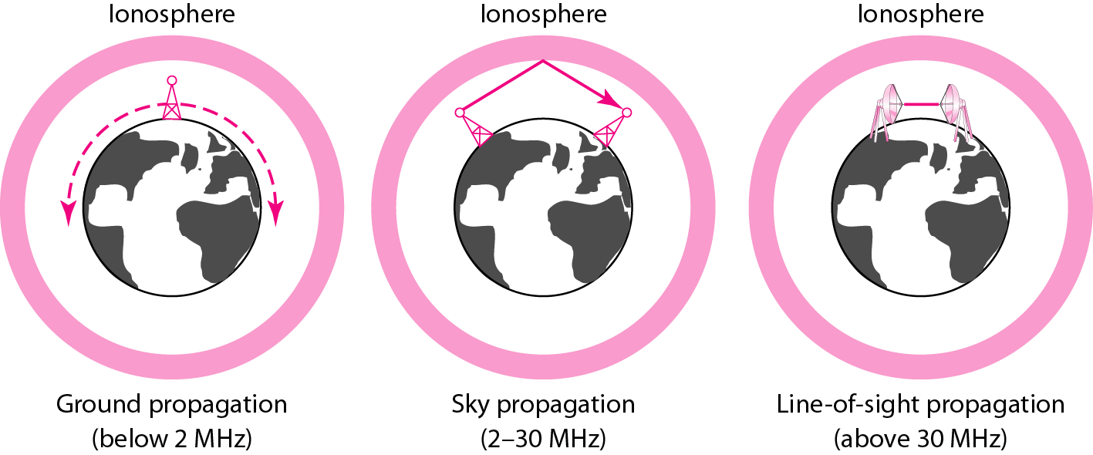
Propagation Methods

Slide 38
Bands

Slide 39
ITS323/CSS331
Wireless Transmission Model
Common wireless systems for communications include:
Transmission
Media
Media and
Spectrum
I
Terrestrial microwave, e.g. television transmission
Satellite microwave, e.g. IPstar
Broadcast radio, e.g. IEEE 802.11 WiFi (wireless LAN) Infrared, e.g. in-home communications
Guided Media
I
Wireless
Transmission
I
Antennas
I
Propagation
Wireless Examples
Transmit
Antenna
Receive
Antenna
Signal
Transmitter
Receiver

Slide 40
ITS323/CSS331
Wireless Transmission Model
Transmission
Media
^{G} _{t}
^{G} _{r}
Media and
Spectrum
Guided Media
^{P} _{t}
L
^{P} _{r}
Wireless
Transmission
Antennas
Propagation
Wireless Examples
I
I
Transmit electrical signal with power Pt
Tx antenna converts to electromagentic wave;
introduces a gain G_{t}
Signal loses strength as it propagates; loss L
Rx antenna converts back to electrical signal, gain G_{r}
I
I I
Receive signal with power Pr

Slide 41
ITS323/CSS331
Contents
Transmission
Media
Media and
Spectrum
Transmission Media and Spectrum
Guided Media
Wireless
Transmission
Guided Media
Antennas
Propagation
Wireless Transmission
Wireless Examples
Antennas and Antenna Gain
Propagation and Path Loss
Wireless Examples

Slide 42
ITS323/CSS331
Antennas
Transmission
Media
I
Antenna converts between electrical current and
electromagnetic waves
Waves are within the Radio and Microwave bands of 3 kHz to 300 GHz
Antenna characteristics are same for sending or receiving
Direction and propagation of a wave depends on antenna shape
Isotropic antenna: power propagates in all directions equally (spherical pattern, ideal)
Omni-directional antenna: power propagates in all directions on one plane (donut)
Directional antenna: power concentrated in particular direction
Power output in particular direction compared to power produced by isotropic antenna is antenna gain [dBi]
Media and
Spectrum
Guided Media
I
Wireless
Transmission
Antennas
I
Propagation
I
Wireless Examples
I
I
I
I

Slide 43
ITS323/CSS331
Example:
Isotropic Antenna (2D)
Transmission
Media
Pr
Media and
Spectrum
Guided Media
Wireless
Transmission
1m
Antennas
Propagation
Pt
Wireless Examples
I
Transmit with power Pt
Measure received power lm away to be P_{r}
Received power is same at any point equidistant from transmitter (black circle)
I
I

Slide 44
ITS323/CSS331
Example:
Directional Antenna (2D)
Transmission
Media
Pr
Media and
Spectrum
Guided Media
Pr
Wireless
Transmission
1m
Px
Antennas
Propagation
Pt
Wireless Examples
Gain = Px
Pr
I
Transmit with same power Pt
Blue shape: at each point, received power is P_{r}
Measure received power lm away to be P_{x}
Gain of antenna (compared to isotropic) is P_{x} /P_{r}
I
I
I

Slide 45
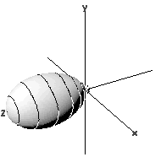

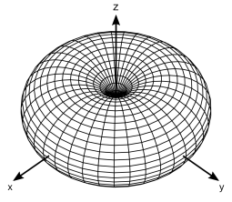
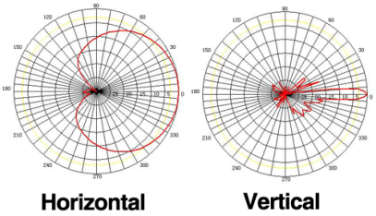
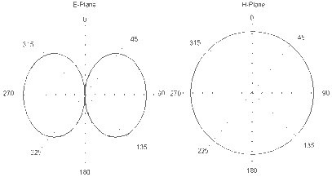
ITS323/CSS331
Antenna Patterns
Transmission
Media
Media and
Spectrum
Guided Media
Wireless
Transmission
Antennas
Propagation
Wireless Examples
Isotropic
Dipole
Horn
Dipole
Sector

Slide 46
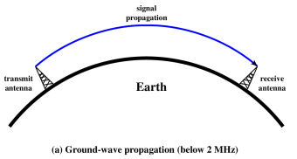
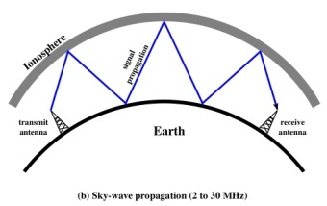
ITS323/CSS331
Wireless Propagation
Transmission
Media
I
I
Frequency of signals affect how signal propagates
Different frequencies impacted by water, atmospheric noise, cosmic noise, temperature
Media and
Spectrum
Guided Media
Wireless
Transmission
Ground Wave
signal follows contour of Earth, e.g. AM radio
Antennas
Propagation
Wireless Examples
Sky Wave signal reflected between ionosphere and Earth,
e.g. amateur radio, international radio stations

Slide 47
ITS323/CSS331
Contents
Transmission
Media
Media and
Spectrum
Transmission Media and Spectrum
Guided Media
Wireless
Transmission
Guided Media
Antennas
Propagation
Wireless Transmission
Wireless Examples
Antennas and Antenna Gain
Propagation and Path Loss
Wireless Examples

Slide 48
ITS323/CSS331
Satellite Communications
Transmission
Media
I
Applications: TV broadcast, remote/marine
communications, positioning, private data networks, Internet
Configuration: point-to-multipoint; point-to-point
Orbits: geostationary (GEO, 36000km), low earth
(LEO, l00's km), . . .
Antennas: parabolic (dish), metre to l0's of metres
Frequency bands: C, Ka, Ku bands
See example of IPStar
Media and
Spectrum
Guided Media
Wireless
Transmission
I
Antennas
I
Propagation
Wireless Examples
I
I
I

Slide 49
ITS323/CSS331
Terrestrial Wireless
Transmission
Media
I
Applications: long distance links, TV broadcast,
AM/FM, Internet
Configuration: point-to-point; point-to-multipoint
Example: IEEE 802.16 (WiMax)
Media and
Spectrum
Guided Media
I
I
Wireless
Transmission
�
11 GHz, 10-20 Mb/s, 10-20 km line of sight
Antennas
Propagation
Wireless Examples

Slide 50
ITS323/CSS331
Mobile Phones
Transmission
Media
I
Applications: personal communications, Internet,
monitoring
Frequency bands: 2.1 GHz, 1.8/1.9 GHz, 85O/9OO MHz; licensed
Bandwidth: 5 MHz for 3G Distance: 1OO's of metres to kms Data Rates: 1OO's kb/s to 1O's Mb/s
Media and
Spectrum
Guided Media
I
Wireless
Transmission
Antennas
I
Propagation
I
Wireless Examples
I

Slide 51
ITS323/CSS331
Local Networks
Transmission
Media
�
Applications: local area network, connect portable
devices
Standards: IEEE 8O2.ll (WiFi) a/b/g/n/ac/. . . ; Bluetooth
Frequency bands: 2.4 GHz and 5.2-5.7 GHz; unlicensed
Bandwidth: 2O MHz channels (increased for optional higher data rates)
Distance: metres to lO's of metres
Data Rates: lO's Mb/s to lOO's Mb/s
Media and
Spectrum
Guided Media
�
Wireless
Transmission
Antennas
�
Propagation
�
Wireless Examples
�
�

